Slide 1

Final Project Deep Learning and Spark with H2o
Maret, Deepa
CSCI E-63 Big Data Analytics
Harvard University Extension School
Prof. Zoran B. Djordjević

Slide 2
Introduction
Problem Statement:
This study assesses how well we can predict whether or not an individual has an income greater than $50,000 per year based on individual’s age, sex, education, marital status, job type, nationality, ethnicity etc., using deep learning libraries in H2o.
Overview of Technology :
Sparking Water (Spark+ H2o), R, R studio
Sparkling Water is a machine learning platform to perform fast, scalable machine learning algorithms of H2O with the capabilities of Spark. R is used as the front end for Sparkling Water. Data is downloaded, cleaned, and visualized in R- studio.
The rsparkling package uses sparklyr for Spark job deployment and initialization of Sparkling Water. After that, h2o R package is used for modeling.
Data Set:
Dataset used is the “Adult” dataset hosted on UCI’s Machine Learning Repository (http://archive.ics.uci.edu/ml/datasets/Adult). It contains approximately 49K observations and 15 variables.

Slide 3
Installation of Software
Download Sparkling Water and follow instructions from http://h2o-release.s3.amazonaws.com/sparkling-water/rel-2.2/4/index.html
RSparkling is a R client for the Sparkling Water applications. To use it: Download and unpack Sparkling Water distribution.
Install RSparkling dependency, Sparklyr
Install Spark
Install H2O of correct version
Finally, install RSparkling
Set Sparkling Water version to be used with Rsparkling
Connect to Spark
h2o_context(sc)
Testing demo to check H2o is working properly or not (demo.h2o.kmeans)

Slide 4
Gathering Data
Downloaded adult data (adult.data and adult.test) set from https://archive.ics.uci.edu/ml/datasets/Adult into the home R directory.
Original data has been split up into training and test subsets, but there doesn't seem to be anything particular about that split, so I will combine those two datasets together and split them into training and test as necessary.
It contains 48842 instances, 15 variables. It is a mix of continuous and discrete (train=32561, test=16281). Prediction task is to determine whether or not a person makes over 50K a year.
Open R studio
Load adult.data and naming columns. adult.data contains 32,561 observations and 15 variables.
Load adult.test and naming columns. adult.test contains 16,281 observations and 15 variables.
Combine adult_data and adult_test to adultDat

Slide 5
Cleaning up Data
Removing variable "final weight". Now, adultDat contains 48,842 observations and 14 variables.
Removing education variable since I will use only education.num instead of education. Now, adultDat contains 48,842 observations and 13 variables.
Reordering columns; continuous variables followed by categorical variables
Cleaning up income variable (Dependent variable). Reducing levels from 4 (<=50K, >50K, <=50K. and >50K.) to 2 (<=50K and >50K)
Cleaning up marital_status. reduced levels to 2 (Married and Single)
Native_country variable. Reduced levels to 2 (US and Non-US)
Cleaning up occupation variable. reduced levels to 13. Removed rows with " ?" and " Armed-Forces"
Cleaning up race variable. Reduced to 2 levels (White and Non-White)
Cleaning up work_class variable. reduced levels to 3 (Private, gov, and Self-emp). Removed levels " Without-pay" and " Never-worked"
45,187 observations and 13 variables

Slide 6
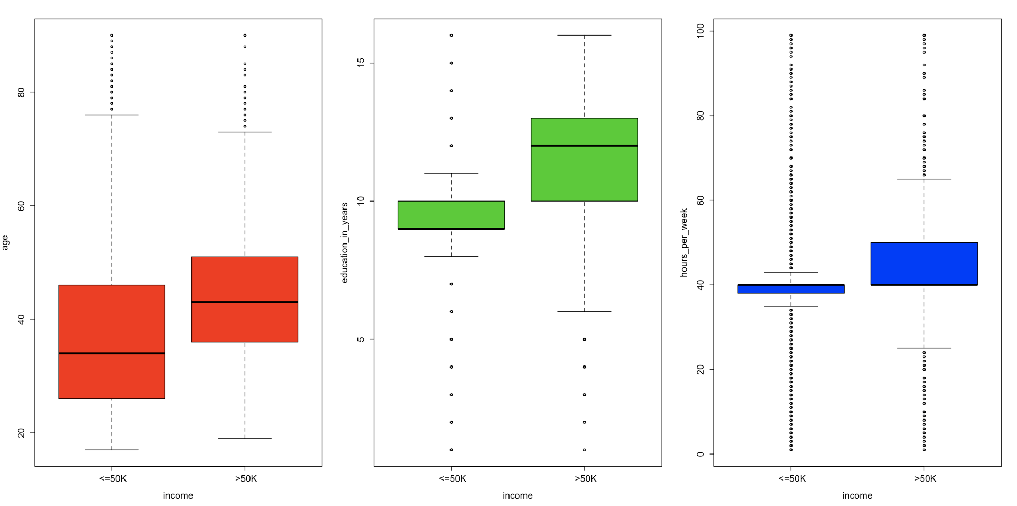
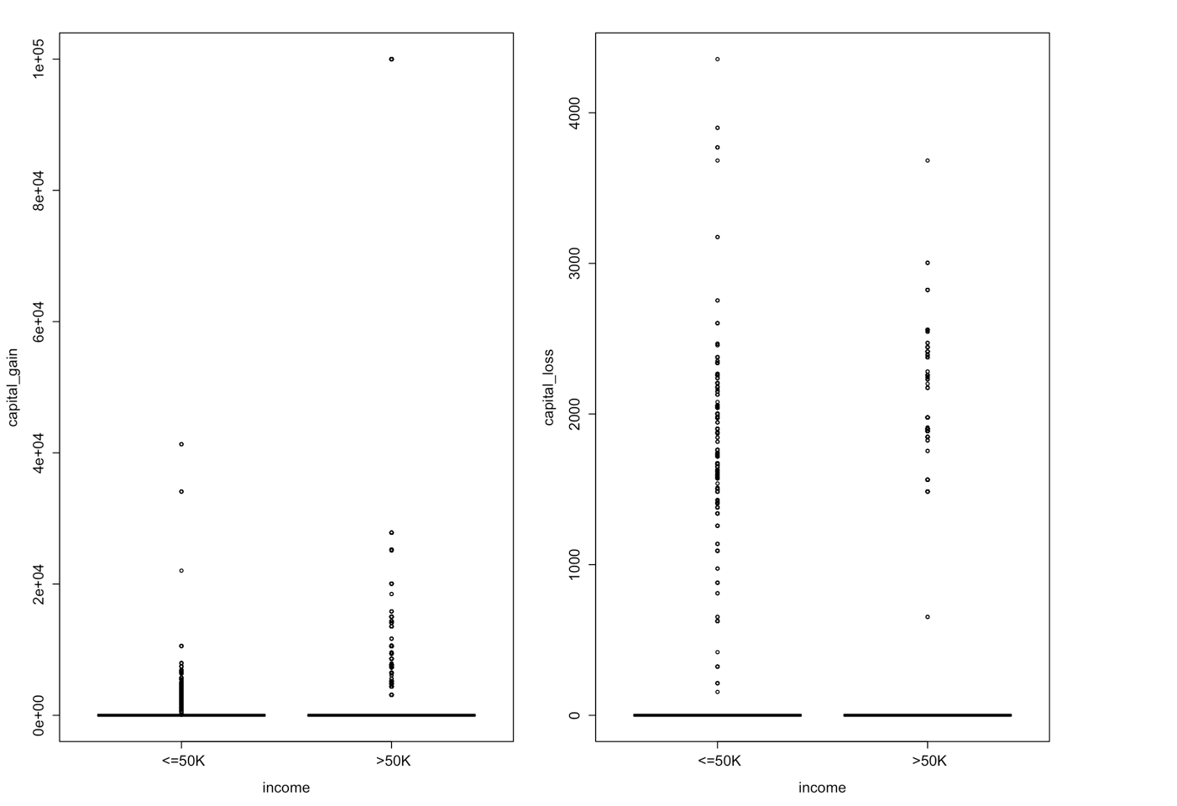
Data Visualization: Plotting quantitative variables against income

Slide 7
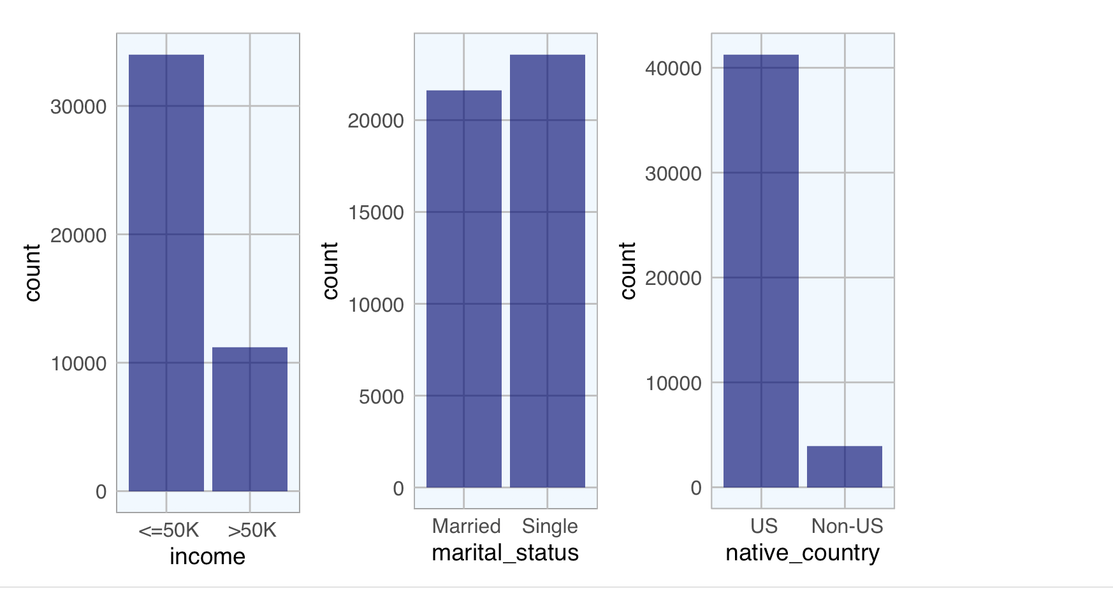
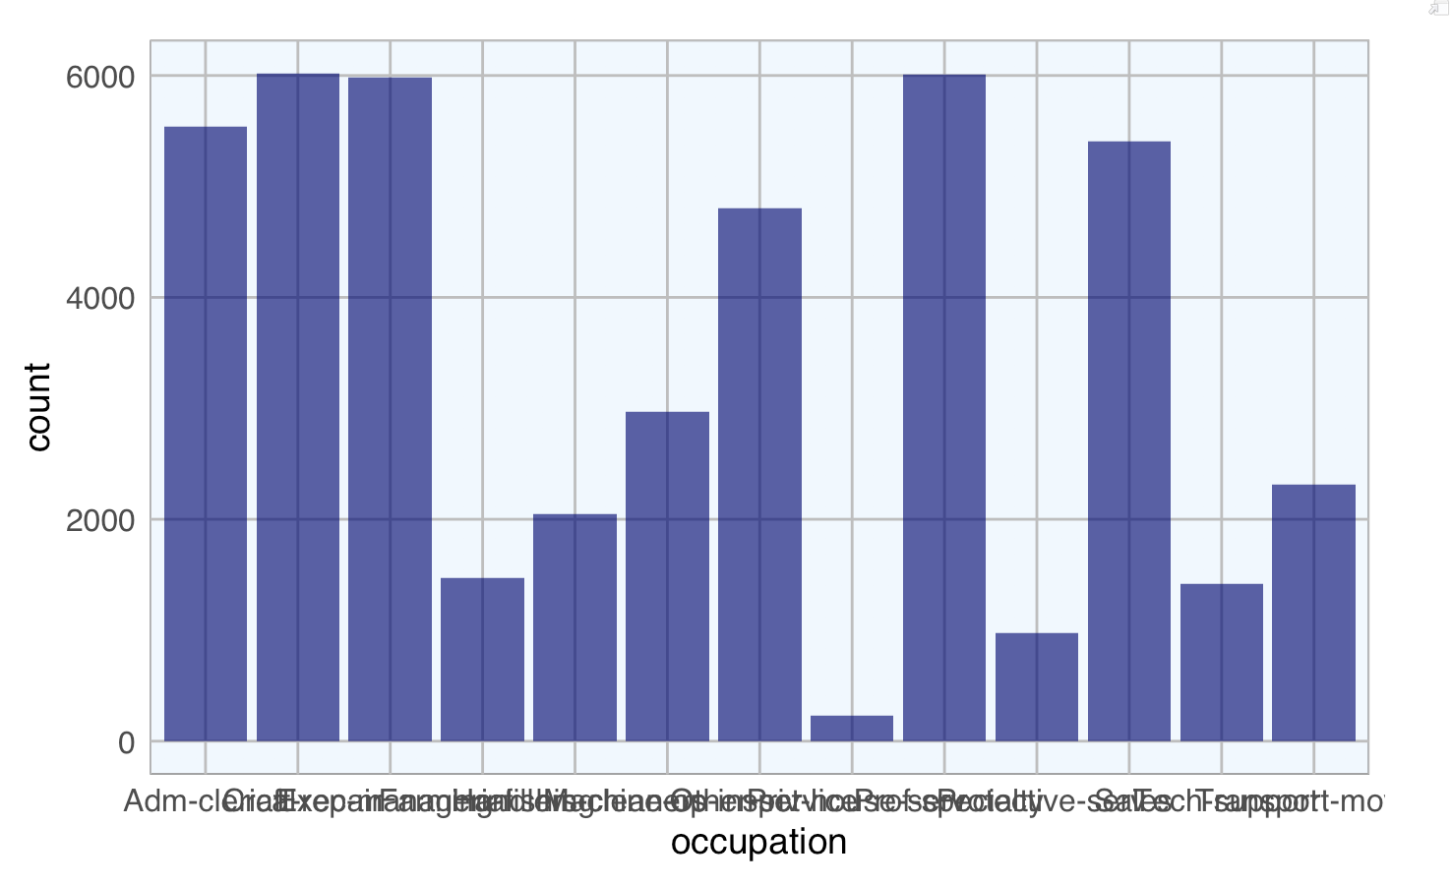
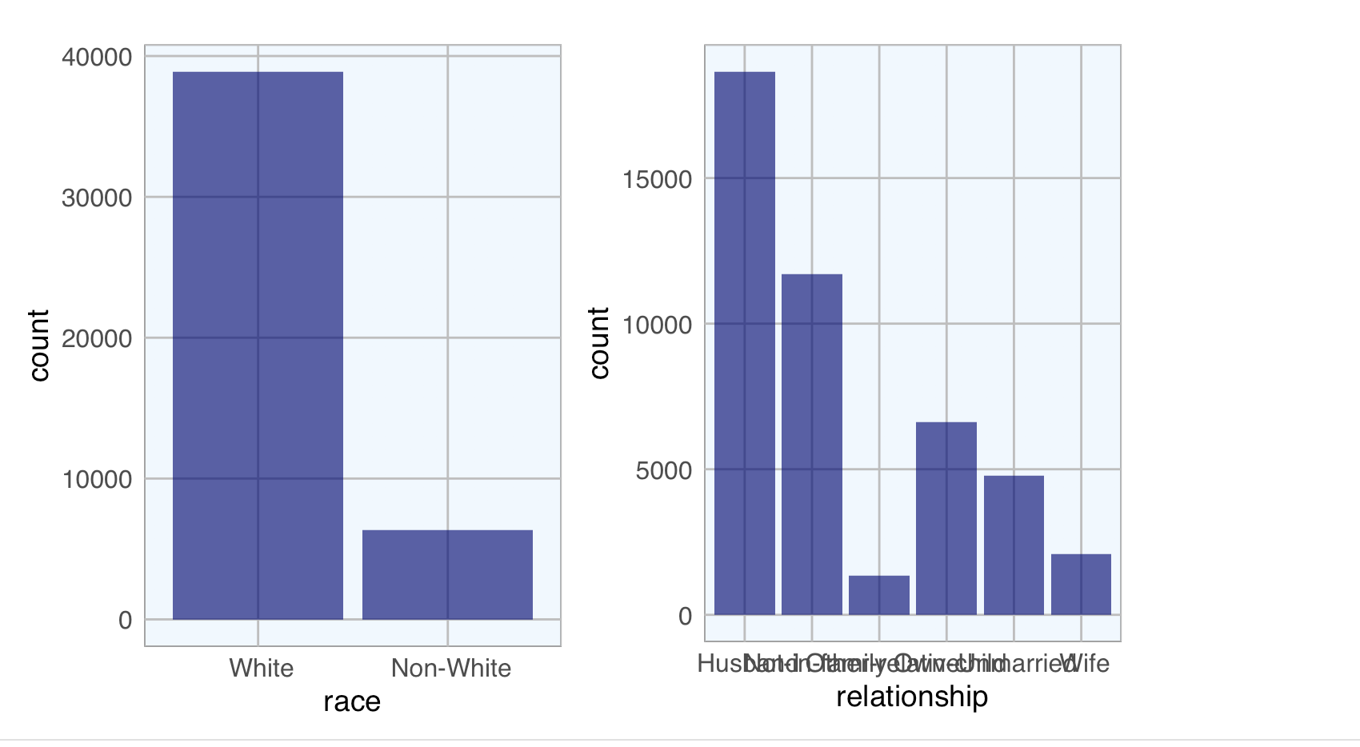
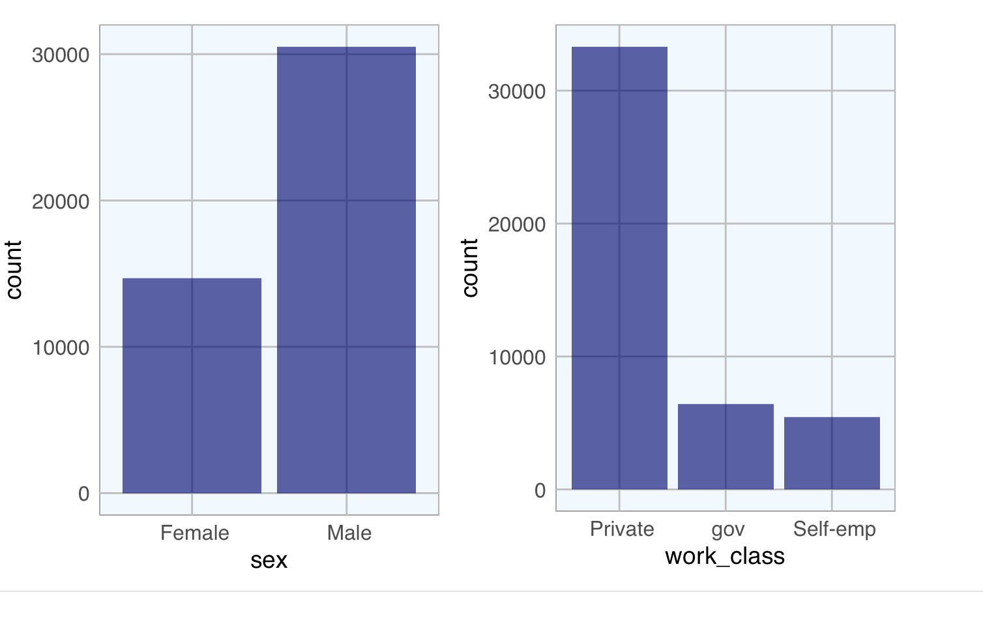
Data Visualization: Plotting Categorical Variables

Slide 8
Deep Learning- Data Preparation
Load packages: rsparkling, sparklyr, h2o, dplyr. H20 connection is successful.
Initialize local Spark connection and copied adultDat data set into spark.
Convert Spark Data Frames to h2o Frames. Then h2o R interface can be used to train H2O machine learning/ deep learning algorithms on the data.
View data h2o data frame
Convert categorical variables as factors. Since the response is encoded as integers, we need to tell H2O that the response is in fact a categorical/factor column. Otherwise, it will train a regression model instead of multiclass classification.
Split the data into train, valid, and test
Define response variables and predictor variables
Response variable is income
Categorical variables are age, education_num, hours_per_week, capital_gain, capital_loss, marital_status, native_country, occupation, race, relationship, sex, work_class

Slide 9
Training Deep Learning Models
Model1:
First we will train a basic DL (deep learning) model with mostly default parameters.
Model 2:
In the second model, we will increase the number of epochs by setting epochs=50 (the default is 10). Increasing the number of epochs in a deep neural net may increase performance of the model, however, we need to be careful not to over fit your model to training data. To automatically find the optimal number of epochs, I used H2O’s early stopping functionality. Unlike the rest of the H2O algorithms, H2O’s DL will use early stopping by default. So for comparison, I will first turn off early stopping. I will do this in the next example by setting stopping_rounds=0
Model 3:
Train deep learning neural net with early stopping: This example will use the same model parameters as adult_dl_model2. However, this time, we will turn on early stopping and specify the stopping criterion. We will use cross-validation (nfolds=3 to determine the optimal number of epochs. Alternatively, we could pass validation set to the validation frame argument (note: the validation set must be different than the test set).

Slide 10
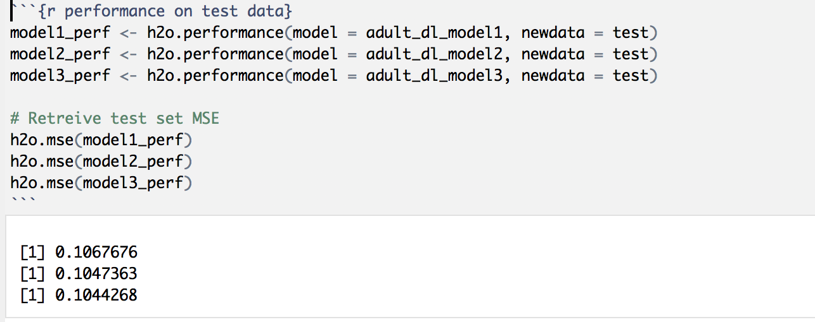
Compare the Performance of Three Models
USED MSE a Measure of Performance
Model 3 performed slightly better than Model 2 and Model 1
MSE for Model 1 is 0.1067676
MSE for Model 2 is 0.1047363
MSE for Model 3 is 0.1044268

Slide 11
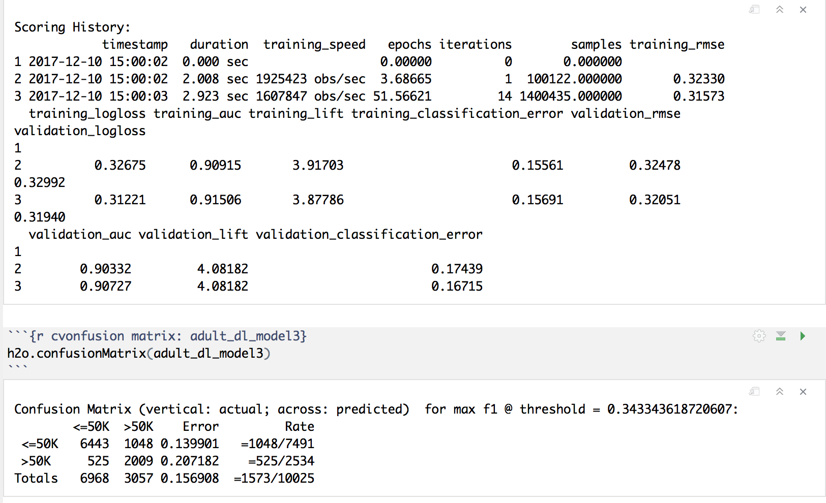
Model 3: Scoring History & Confusion Matrix

Slide 12
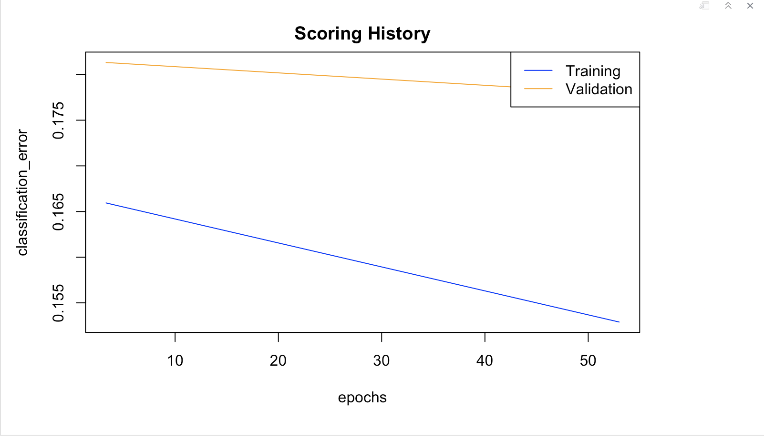
Model 3: Plotting Scoring History

Slide 13
Deep Learning Grid Search
First define a grid of Deep Learning hyper parameters and specify the search criteria.
Rather than comparing models by using cross-validation (which is “better” but takes longer), we will simply partition our training set into two pieces – one for training and one for validation.
Train the random grid. Fixed non-default parameters such as hidden=c(2,2) can be passed directly to the h2o.grid() function.
Collect the results and sort by our model performance metric of choice.
Grab the model_id for the top DL model, chosen by validation error.
Evaluate the model performance on a test set so we get an honest estimate of top model performance.
Top model gave MSE of 0.1093965 which is greater than MSE of Model 3

Slide 14
Summary
Best model has approximately 90% prediction accuracy.
This is my first class in the field of big data and it provided the platform to learn and practice advanced topics
In future,
Eliminate variables based on variable importance
Try dimensionality reductions before applying deep learning algorithms.
Learn to tune parameters better in order to achieve higher accuracy.
Try all of the Machine learning algorithms in H2o
Benchmark prediction accuracy against Tensorflow
Work on a bigger data set with millions and trillions of observations

Slide 15
You Tube Links and References
You Tube links:
2 Minute Presentation: https://youtu.be/S_YDfDG_PXQ
15 Minutes Presentation: https://youtu.be/5ee7IYn-6x4
References:
http://docs.h2o.ai/h2o/latest-stable/h2o-docs/data-science/deep-learning.html
https://archive.ics.uci.edu/ml/datasets/Adult
https://htmlpreview.github.io/?https://github.com/ledell/sldm4-h2o/blob/master/sldm4-deeplearning-h2o.html
https://spark.rstudio.com/guides/h2o/
http://docs.h2o.ai/h2o/latest-stable/h2o-docs/welcome.html
https://databricks.com/spark/about
http://h2o-release.s3.amazonaws.com/h2o/master/3888/docs-website/h2o-docs/faq/sparkling-water.html
https://github.com/h2oai/rsparkling
http://docs.h2o.ai/h2o/latest-stable/h2o-docs/welcome.html

